Slide 1
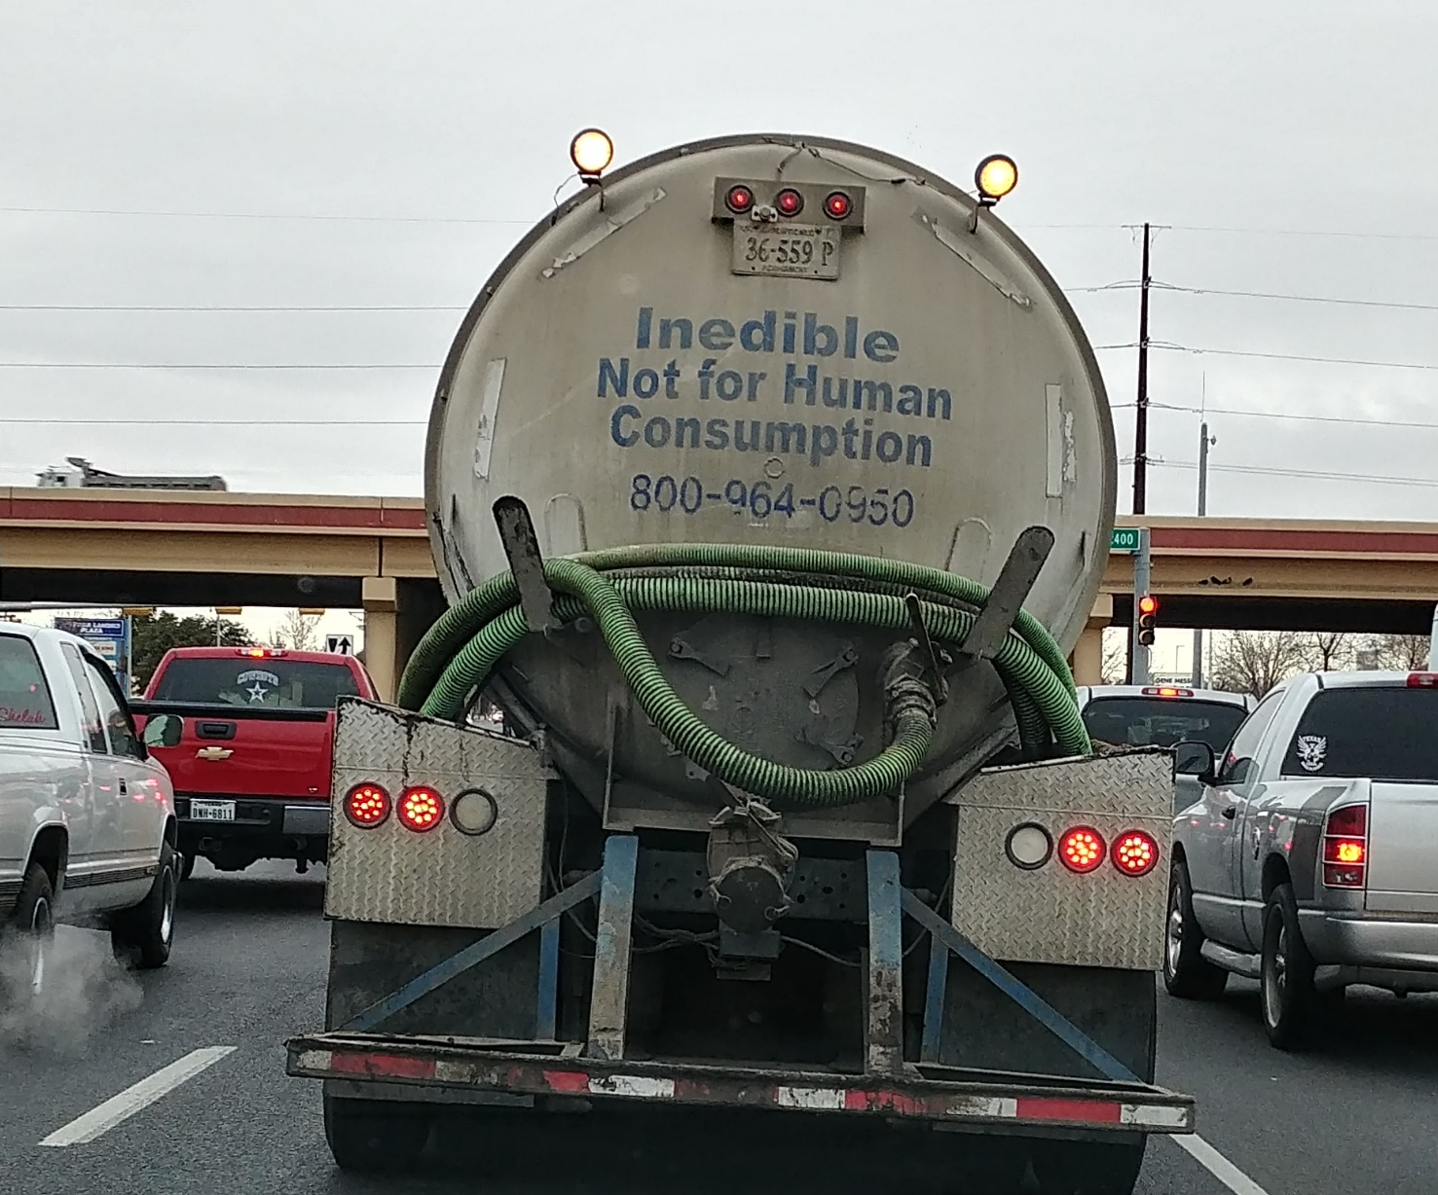

Slide 2
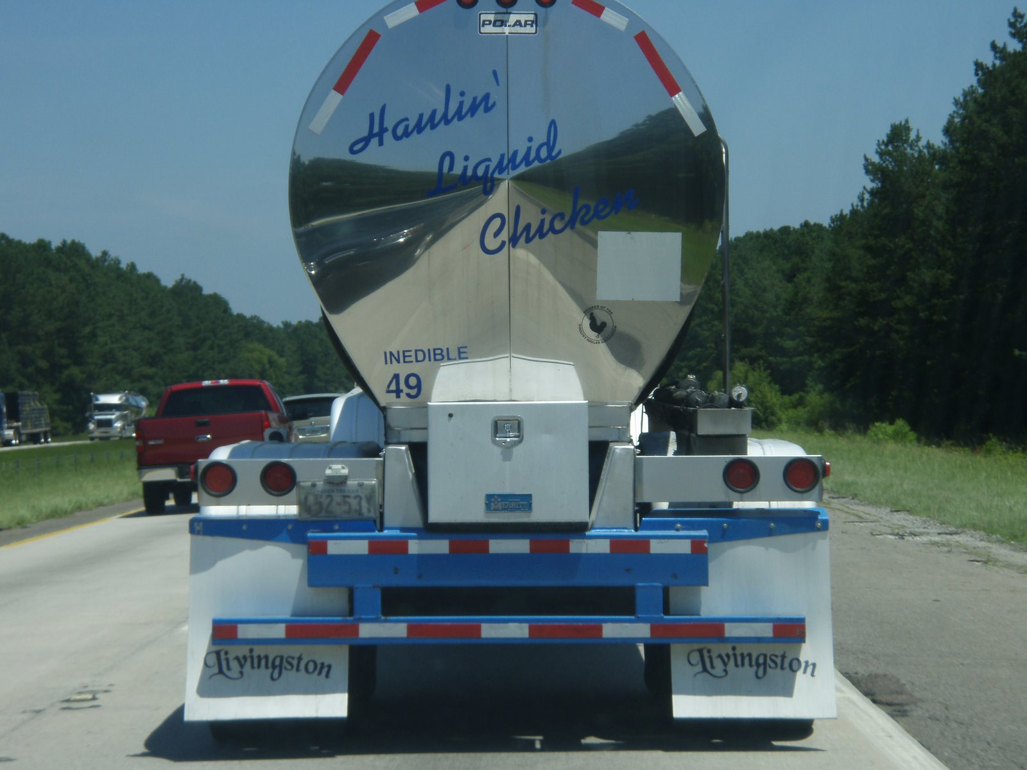

Slide 3
Hydraulic Profiles in Wastewater Treatment Plants
Source
Syed Qasim, 1999. Wastewater Treatment Plants: Planning, Design and Operation, 2nd Edition, Technomic, Lancaster, PA, 1106 p.

Slide 4
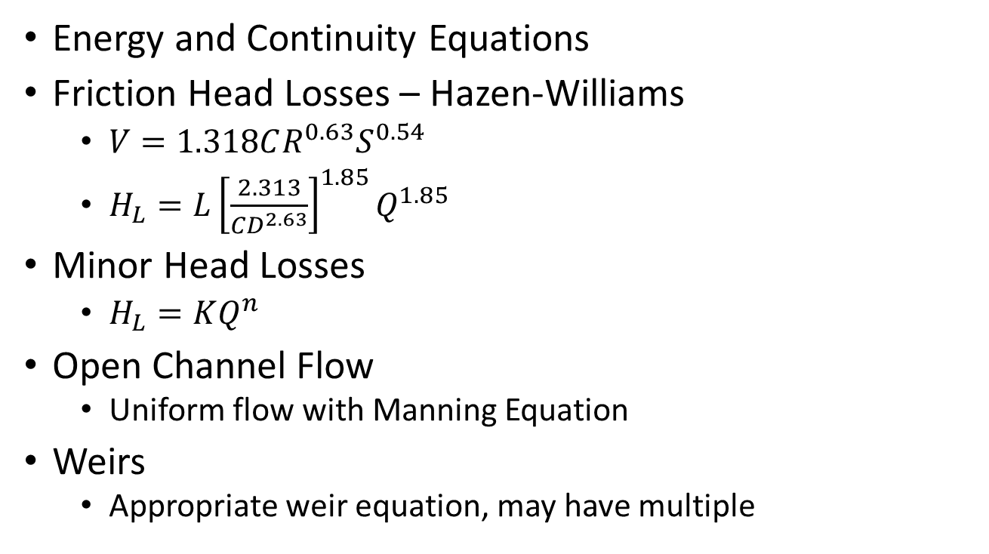
Hydraulic Equations
Energy and Continuity Equations
Friction Head Losses – Hazen-Williams
$V=1.318CR^{0.63}S^{0.54}$
$H_{L}=L{\left[\frac{2.313}{CD^{2.63}}\right]}^{1.85}Q^{1.85}$
Minor Head Losses
$H_{L}=KQ^{n}$
Open Channel Flow
Uniform flow with Manning Equation
Weirs
Appropriate weir equation, may have multiple

Slide 31
Flows and Head Losses
Energy equation is used everywhere!
Bar rack
Head losses
Expansion
Through bars
Critical flow at effluent structure free overfall
Proportional weir
Pump station
System head curve – static lift, friction and minor losses
Pump performance

Slide 32
Flows and Head Losses
Venturi flow meter
Venturi equation
Grit chamber
Sized based on detention time and flow
Overflow rate based on area
Head losses in influent channel
Weir flow for effluent flow
Backwater analysis for flume with free overfall
Head loss caused by drag forces on baffle walls

Slide 33
Flows and Head Losses
Primary Sedimentation
Sized for detention time and flow
Overflow rate
Head losses in influent structure, may include orifice flow through baffle wall
Weir flow at effluent structure
Open channel flow depth in launder
Head loss in pipe after launder
Junction box shows local total head

Slide 34
Flows and Head Losses
Secondary Reactors
Sized for detention time and flow
Head losses in influent structure
Weir flow at effluent structure
Head loss in pipe to secondary clarifiers
Secondary Clarifiers – like primary sedimentation
Head loss in pipe after launder
Junction box shows local total head

Slide 35
Flows and Head Losses
Disinfection
Sized based on lamp operation
Head loss through lamps
Head loss through influent structure, typically rectangular weir
Parshall flume – see manufacturer’s specifications for head loss and flow relationship
Outfall
Open channel flow – Manning equation
Outfall pipe – friction and minor losses

